Slide 1
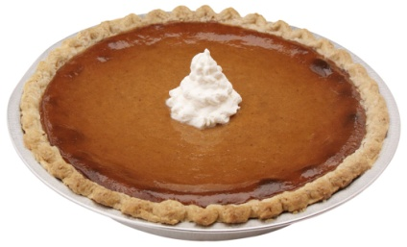
September News Letter
Officers
Maggie Swonger-President
(423)202-2965
Matt Lampkins-VP
(423)366-8399
Autumn Roe- Secretary
(423)612-2931
Hope Leonard- Treasurer
(423)502-0806
Dustin Fortner- Sentinel
(423)384-4434
Mike Smith- Advisor
(423)276-3270
FFA Kick off!
Where? Volunteer Baptist Church When? September 8 meet at East at 5
Bring? Guys bring salty food girls bring sweet stuff.
Fall Festival
When? October 27
Where? East, time is TBA
What? We need donations, posters made, and help at the festival.
November 10 Fenders Farm time TBA
Dues Are Due September 12!
If any questions please feel free to ask anyone of the officers!
Don’t forget your food for the kick off!
www.Sullivaneast.ffanow.org

